Slide 1
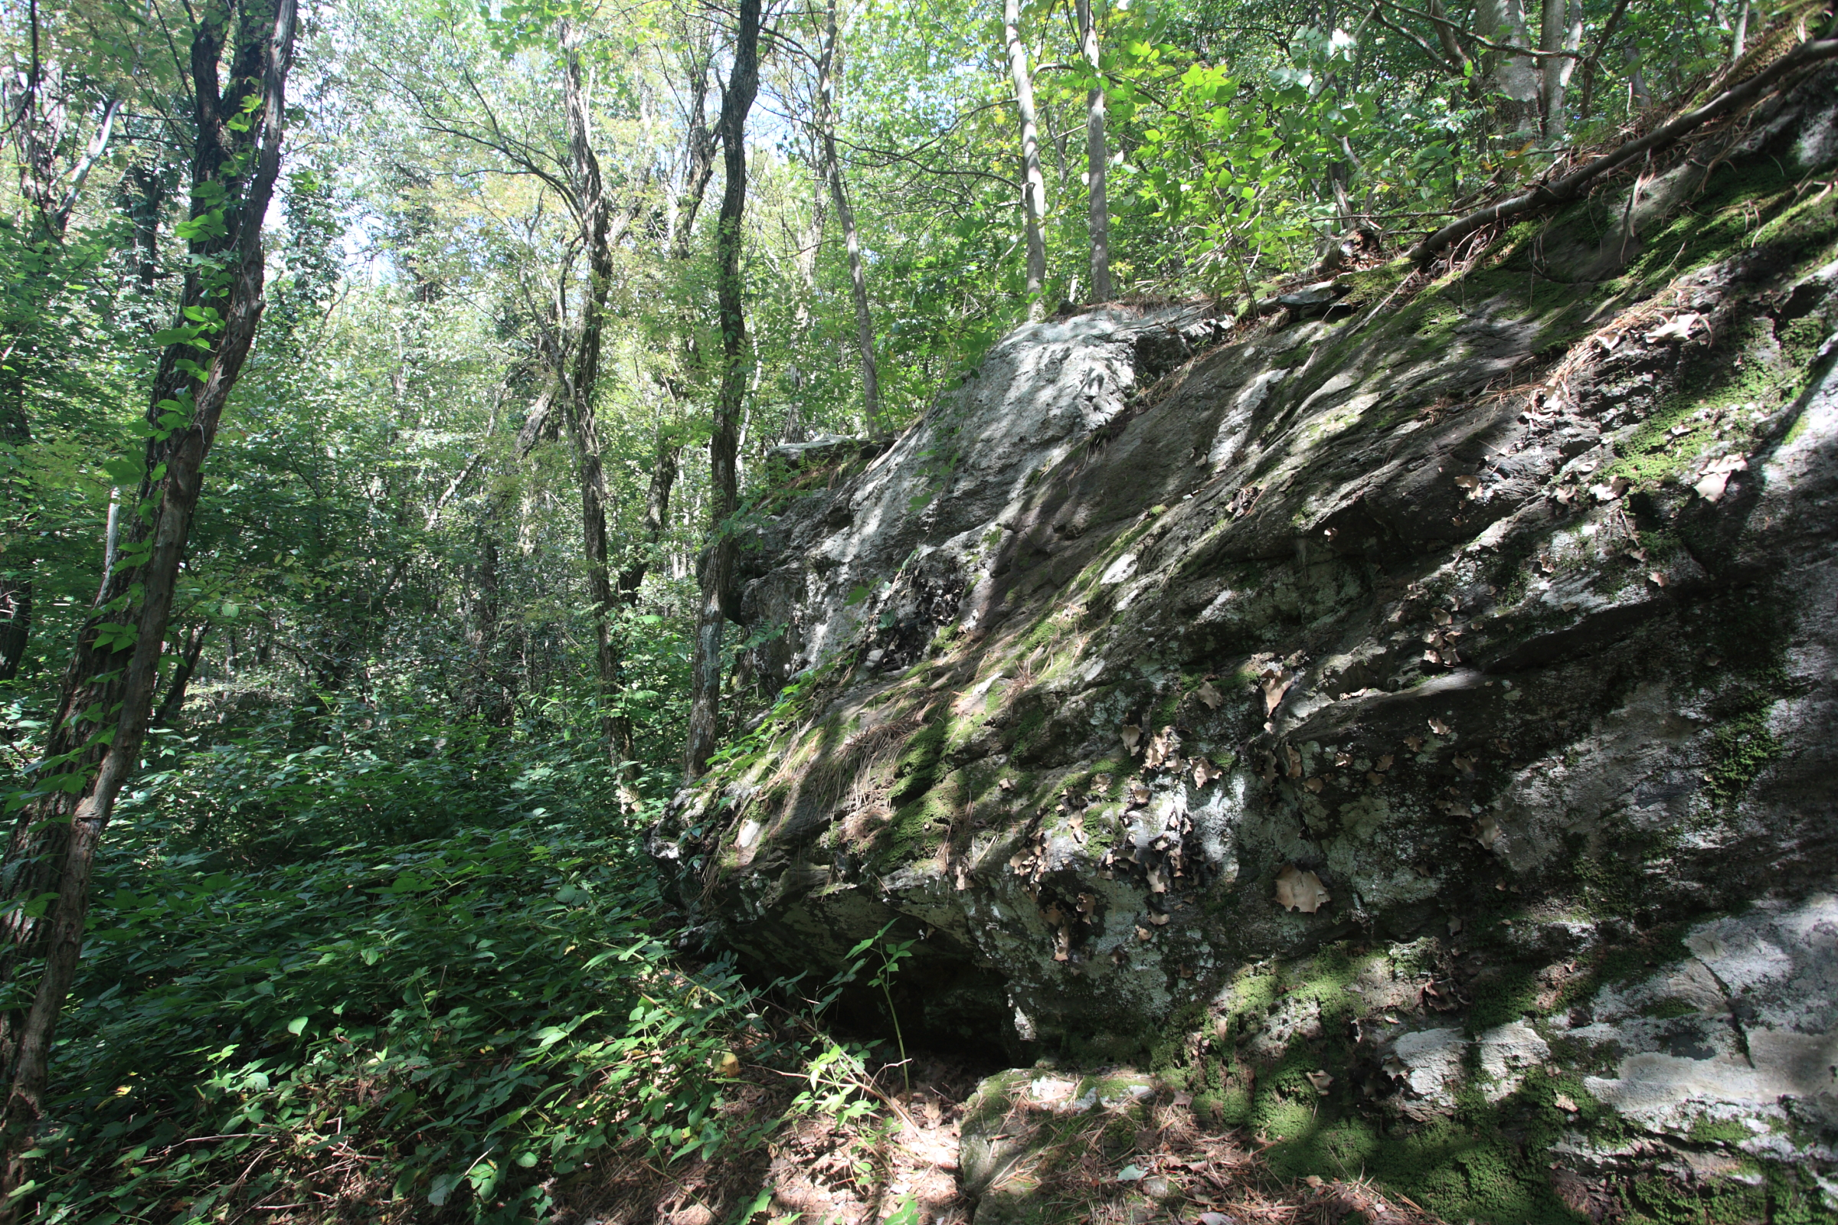
Class 14:
Selfish Mining
Cryptocurrency Café
UVa cs4501 Spring 2015
David Evans

Slide 2
Plan for Today
2140 (?)
Selfish Mining
Attacks on the Blockchain
Reminders: Project 2 due Thursday
Project Ideas: preliminary project proposal will be due March 19 (present in class on March 23)

Slide 3
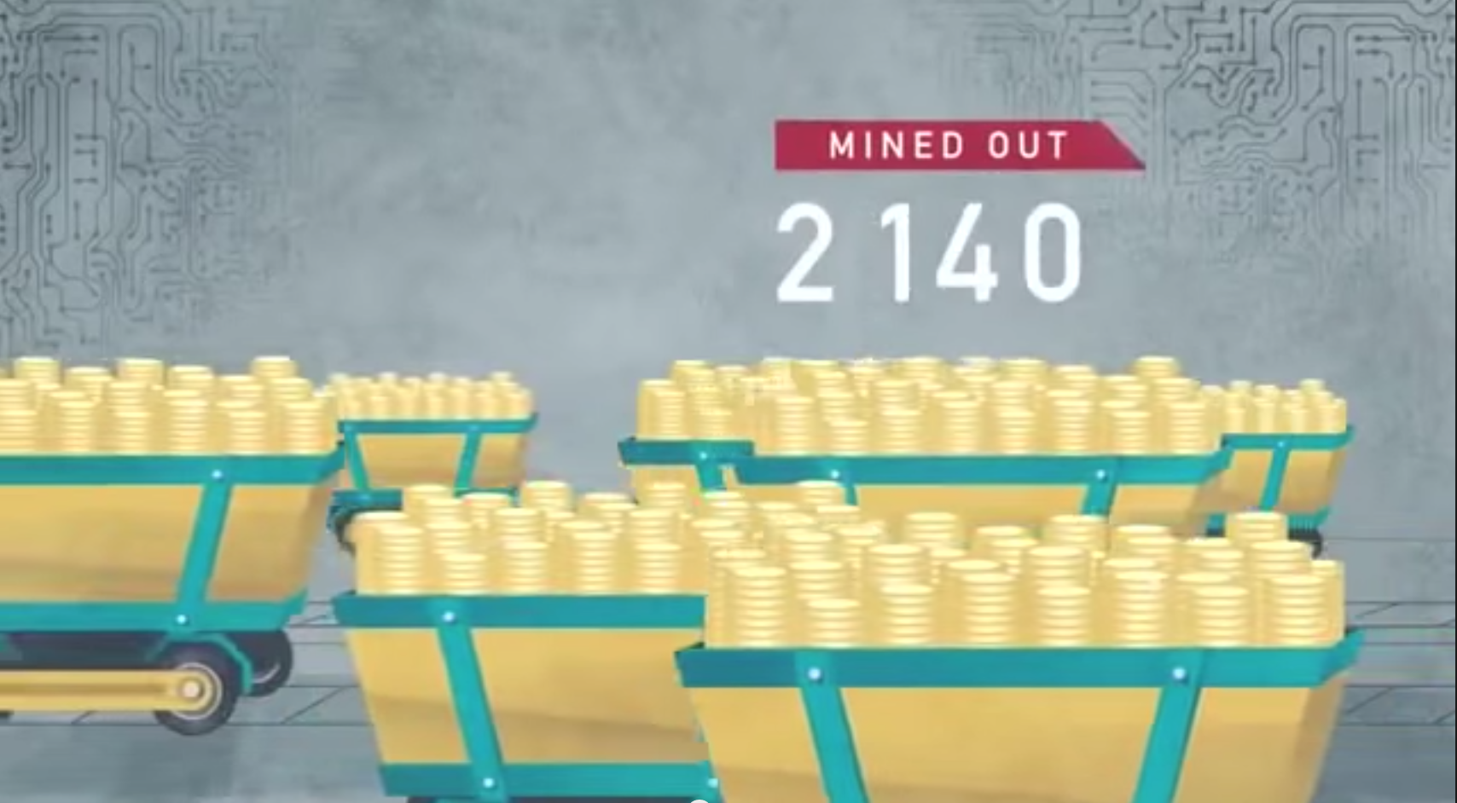
Why 2140?

Slide 4
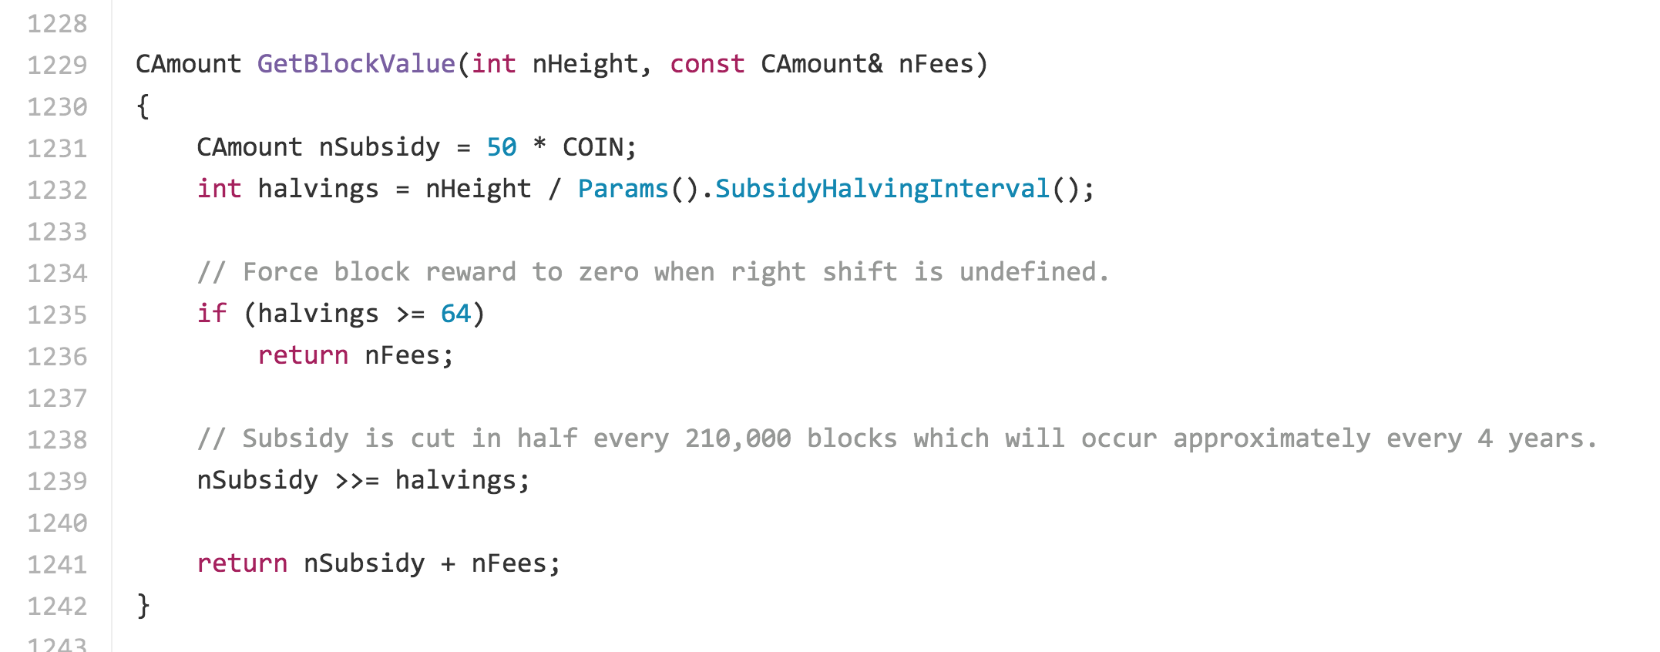
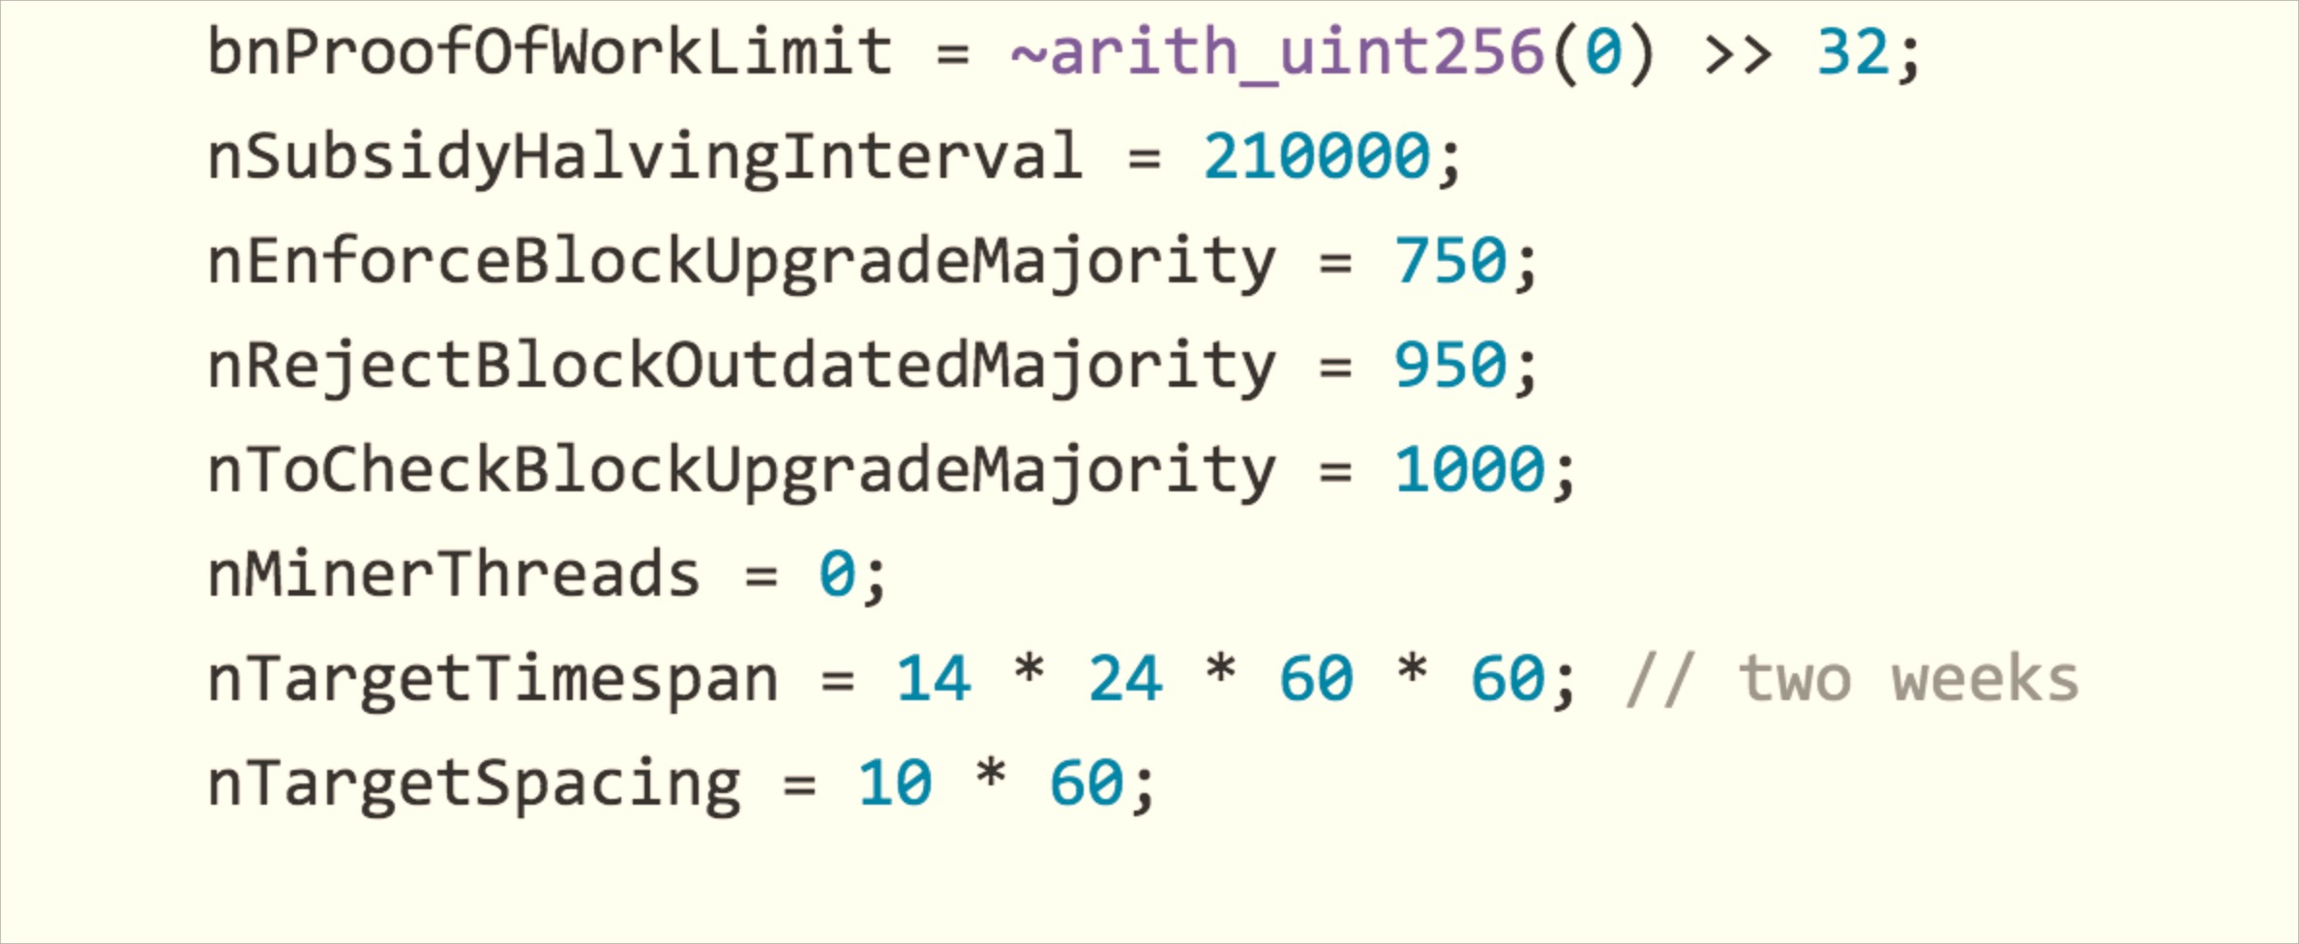

Slide 5
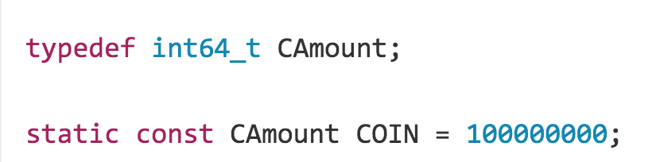

Slide 6
INTERVAL = 210000
COIN = 100000000
def subsidy(height):
val = 50 * COIN
halvings = height / INTERVAL
val = val >> halvings
return val
>>> subsidy(0)
5000000000
>>> subsidy(1)
5000000000
>>> subsidy(210000)
2500000000
>>> subsidy(345869)
2500000000
>>> subsidy(420000)
1250000000
>>> subsidy(210000 * 3)
625000000
>>> subsidy(210000 * 4)
312500000
…
>>> subsidy(210000 * 20)
4768
>>> subsidy(210000 * 30)
4
>>> subsidy(210000 * 31)
2
>>> subsidy(210000 * 32)
1
>>> subsidy(210000 * 33)
0

Slide 7
2140?
Last block with a subsidy: (210000 * 33) – 1 = 6,929,999
“Expected” time to reach block =
time of block 0 + 6929999 * 10 minutes/block

Slide 8
import datetime
def expect_block(block):
minutes = block * 10
start = datetime.datetime.strptime("2009-01-03", "%Y-%m-%d")
return start + datetime.timedelta(minutes=minutes)
>>> print expect_block(0)
2009-01-03 00:00:00
>>> print expect_block(6929999)
2140-10-07 23:50:00
>>> print expect_block(345871)
2015-08-01 21:10:00

Slide 9
>>> (now - genesis) / 345871
datetime.timedelta(0, 561, 809460)
Why is average time per block 561.8 seconds, not 600?

Slide 10
import datetime
def expect_block(block):
minutes = block * 10
start = datetime.datetime.strptime("2009-01-03", "%Y-%m-%d")
return start + datetime.timedelta(minutes=minutes)
>>> print expect_block(0)
2009-01-03 00:00:00
>>> print expect_block(6929999)
2140-10-07 23:50:00
>>> print expect_block(345871)
2015-08-01 21:10:00

Slide 11
import datetime
def expect_block(block):
minutes = block * (561.8 / 60)
start = datetime.datetime.strptime("2009-01-03", "%Y-%m-%d")
return start + datetime.timedelta(minutes=minutes)
> print expect_block(6929999)
2132-05-19 00:50:38.200000

Slide 12
Selfish Mining
Last Public Block
Mined Block!
H(PrevBlock)

Slide 13
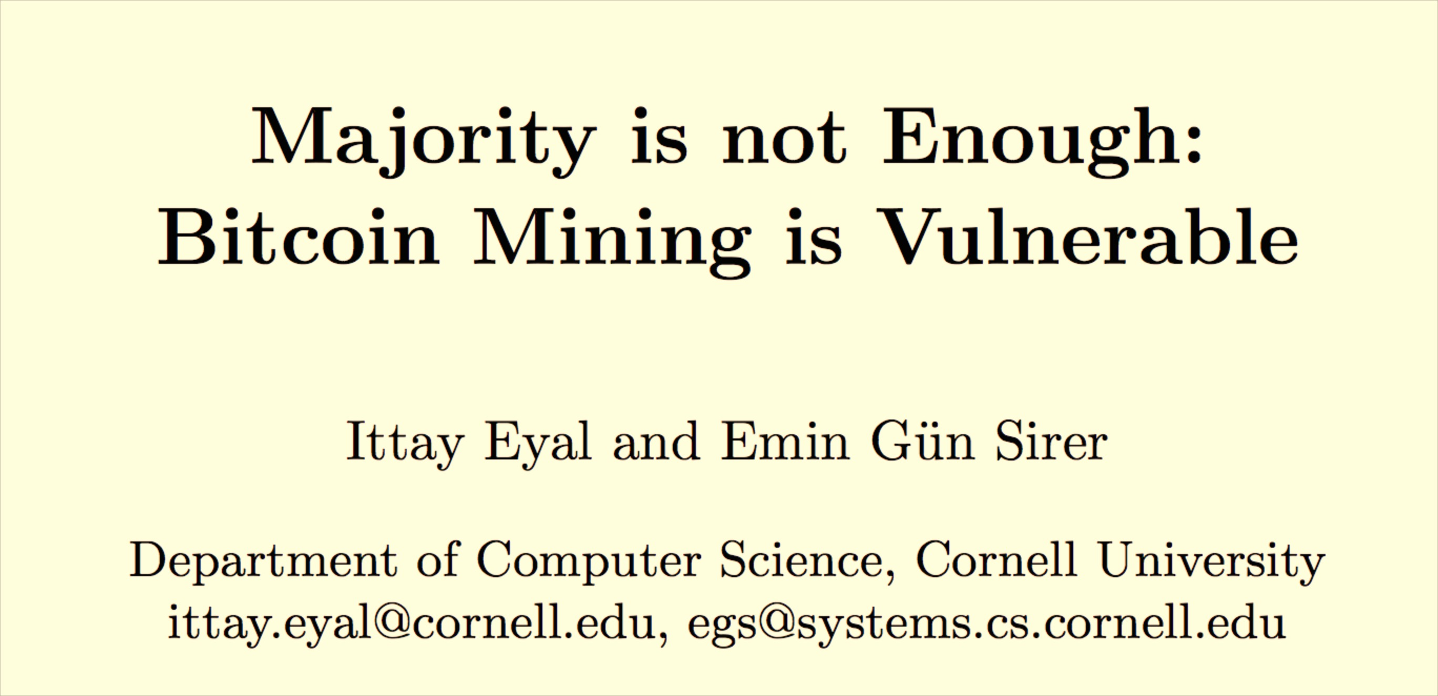
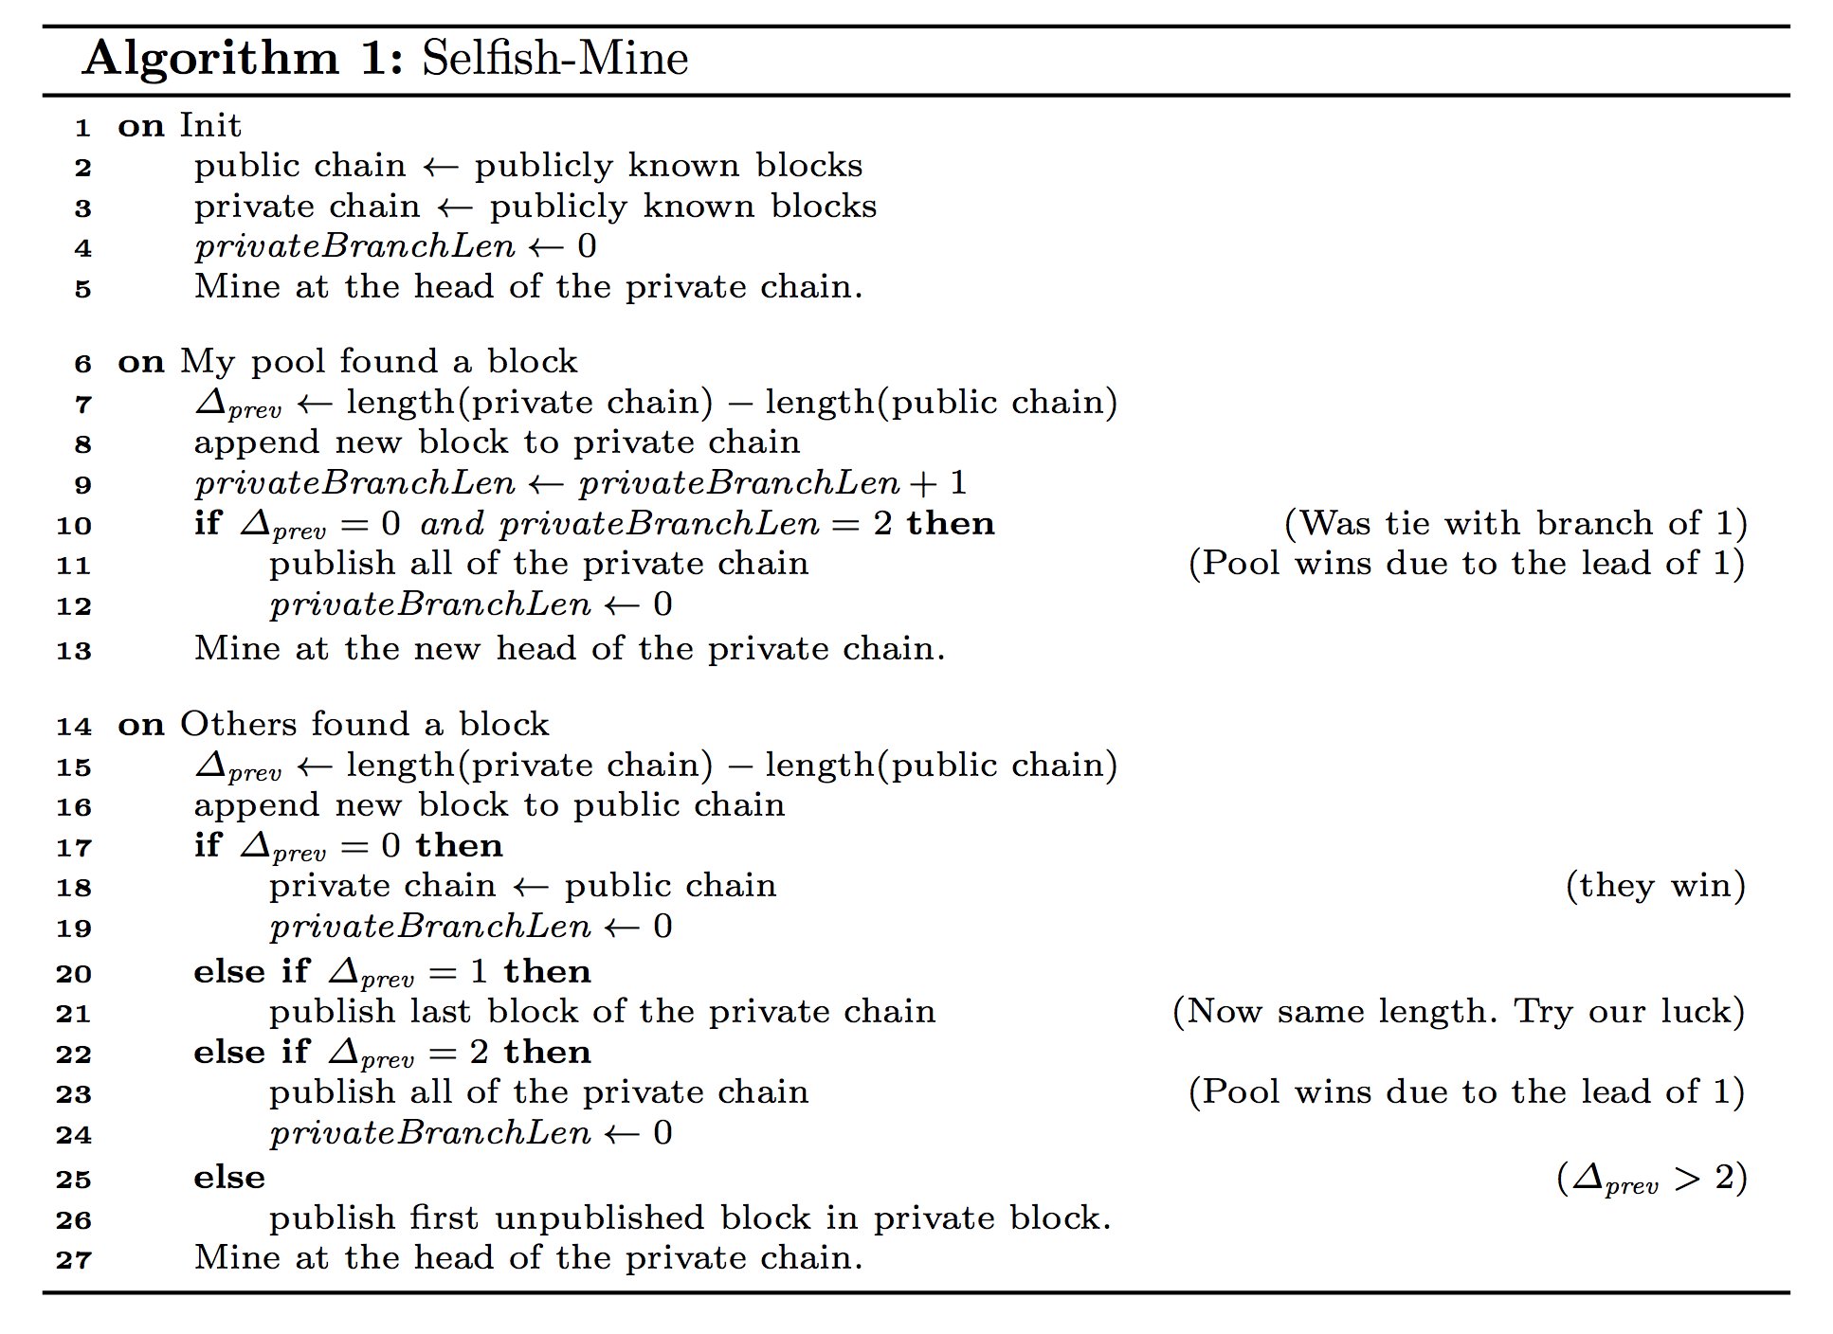

Slide 16
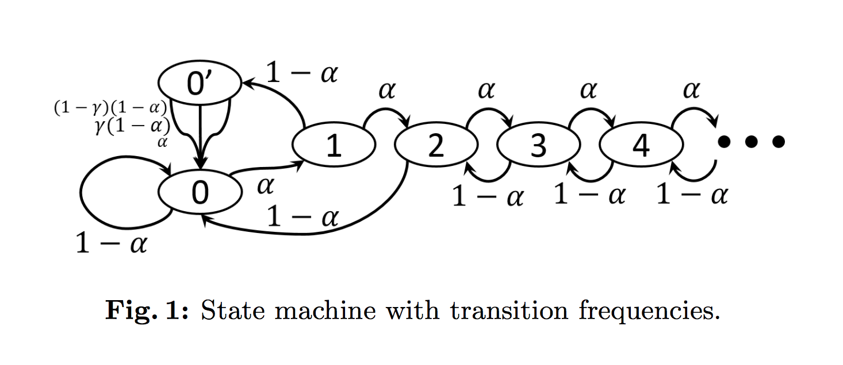
α: fraction of mining power owned by selfish pool
γ: fraction of honest miner’s that mine from selfish branch (given tie block)

Slide 17
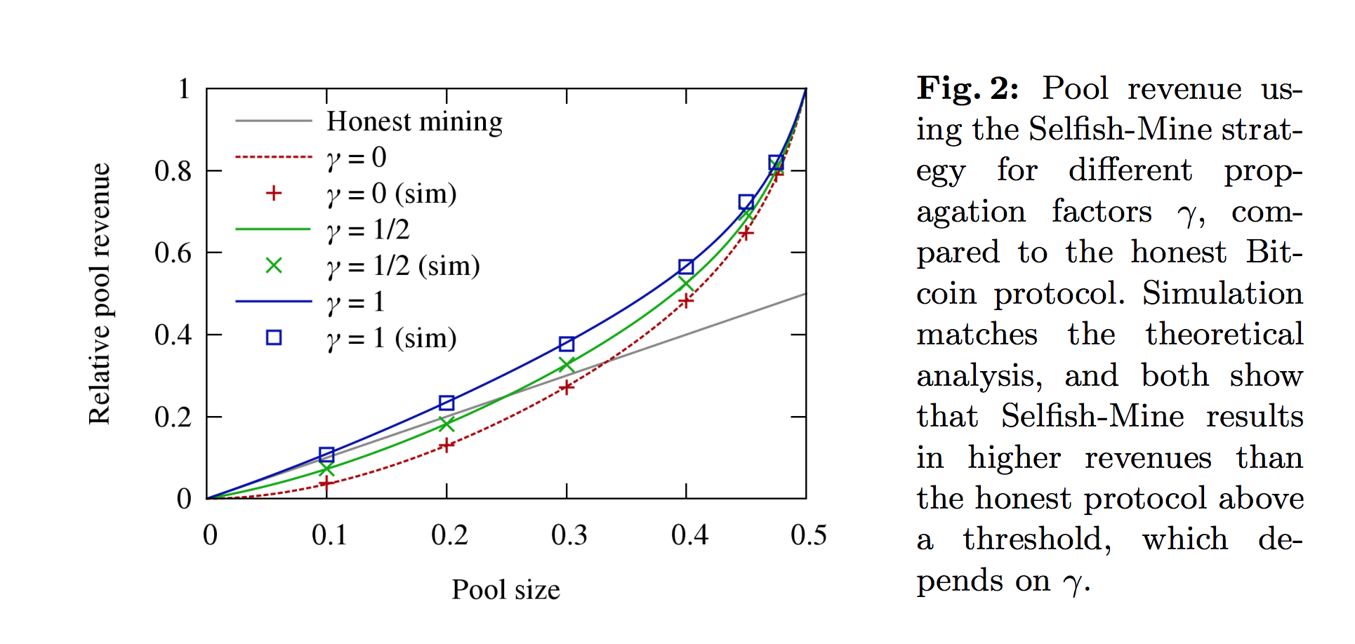

Slide 18


Slide 19
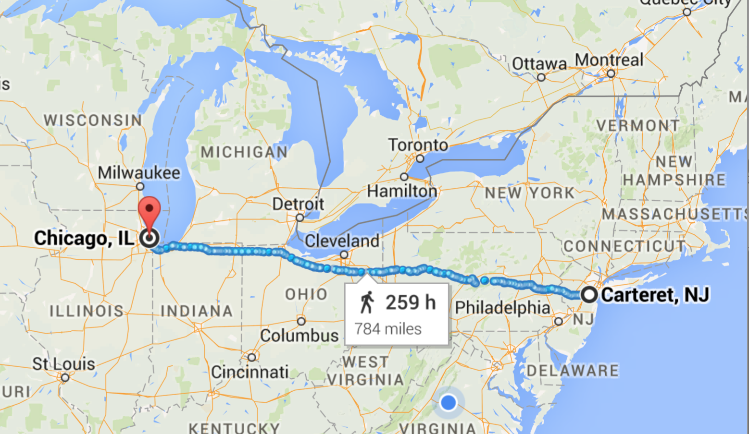

Slide 20
Normal network: 17 ms
Spread Networks ($300M): 13 ms
Chicago Mercantile Exchange
NASDAQ Data Center

Slide 21
Normal network: 17 ms
Spread Networks ($300M): 13 ms (827 miles)
Microwave Links: ~9 ms
1260 km / 299792 km/s = 4ms at lightspeed
Chicago Mercantile Exchange
NASDAQ Data Center

Slide 22
Charge
Project 2 Part 2:
Due Thursday 5 March

